Slide 1
CSE 3666 Single-cycle pipeline diagrams
Created by: Prof. Caiwen Ding at UConn

Slide 2
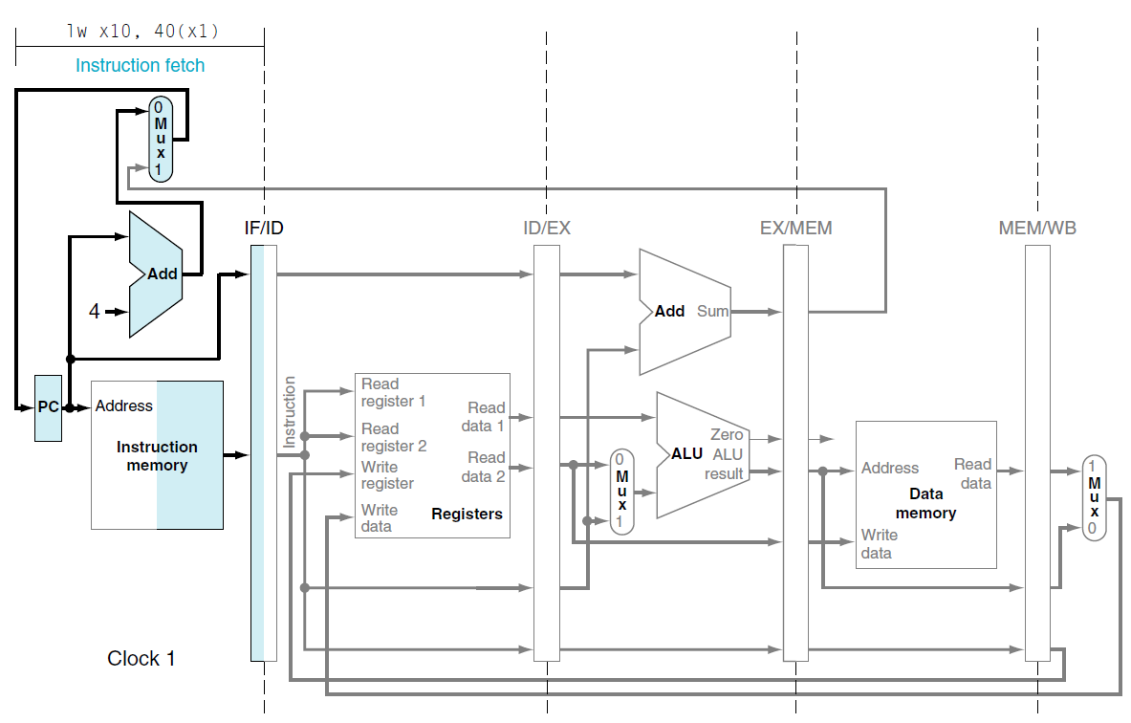
lw x10, 40(x1)
sub x11, x2, x3
and x12, x4, x5
or x13, x6, x7
add x14, x8, x9

Slide 3
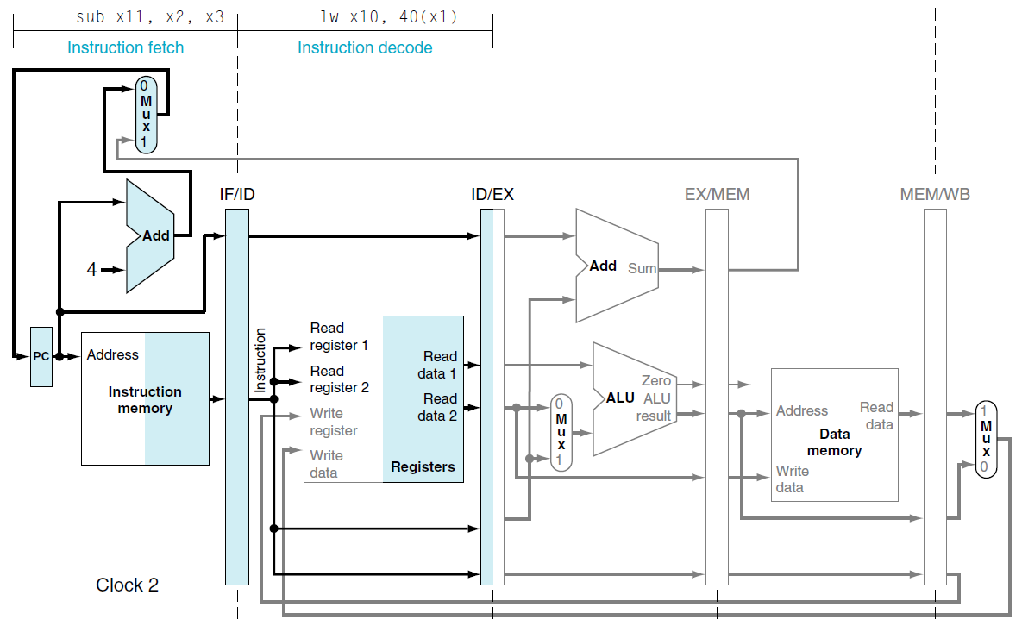
lw x10, 40(x1)
sub x11, x2, x3
and x12, x4, x5
or x13, x6, x7
add x14, x8, x9

Slide 4
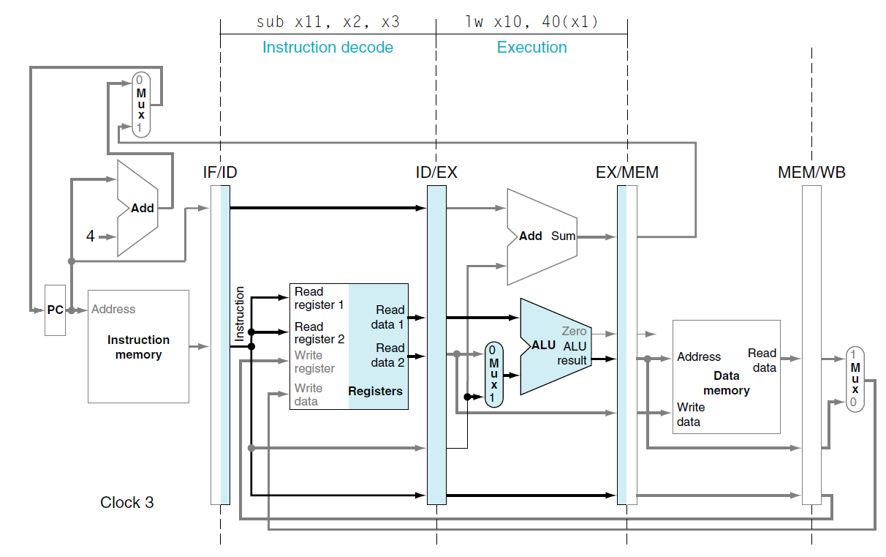
lw x10, 40(x1)
sub x11, x2, x3
and x12, x4, x5
or x13, x6, x7
add x14, x8, x9

Slide 5
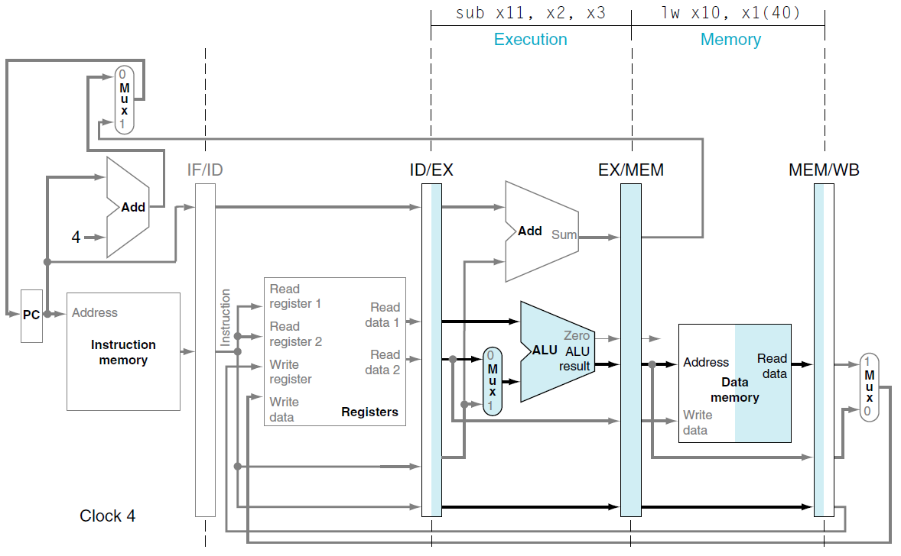
lw x10, 40(x1)
sub x11, x2, x3
and x12, x4, x5
or x13, x6, x7
add x14, x8, x9

Slide 6
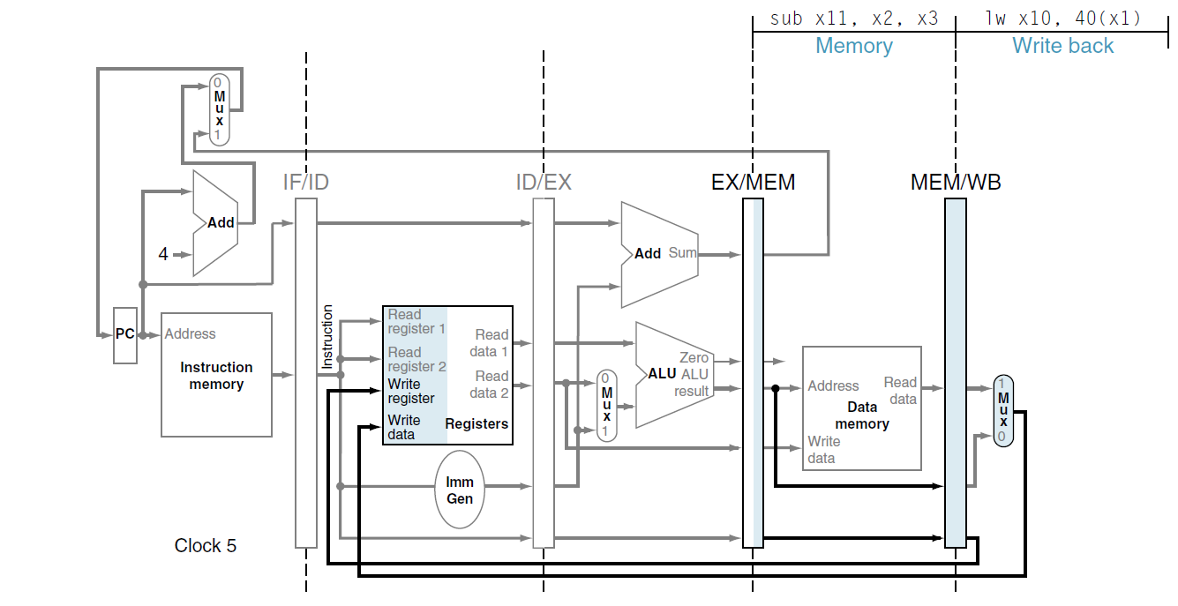
lw x10, 40(x1)
sub x11, x2, x3
and x12, x4, x5
or x13, x6, x7
add x14, x8, x9

Slide 7
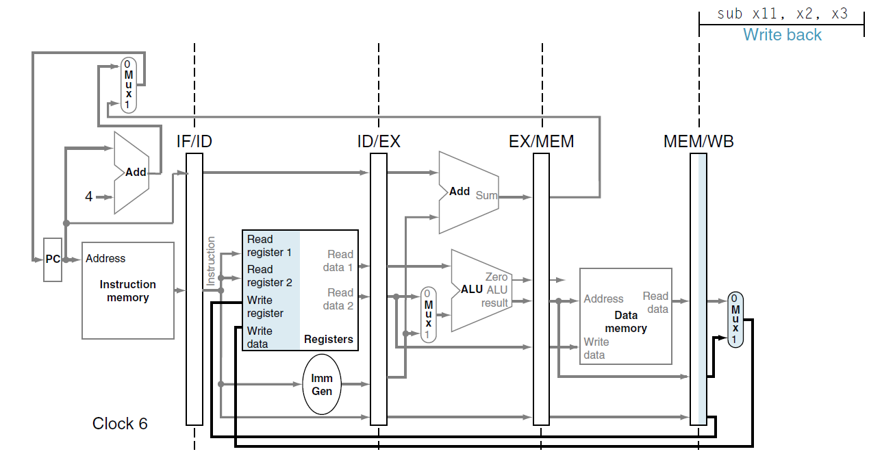
lw x10, 40(x1)
sub x11, x2, x3
and x12, x4, x5
or x13, x6, x7
add x14, x8, x9

